Slide 1

DAYANANDA SAGAR ACADEMY OF TECHNOLOGY & MANAGEMENT Bangalore 560082 , India
Department of Electronics & Communication Engineering
Title: Design and Implementation of DLDO (Digital Low Dropout Regulator)
Presented by
Adith Soragu (1DT23EC003)
A Yaswanth (1DT23EC009)
K Shobith Kumar (1DT23EC040)
Chaluvaraju SN (1DT24EC401)
Under the guidance of
Dr. Roopa R Kulkarni
Associate Professor, ECE Department
Dayananda Sagar Academy of Technology & Management

Slide 2


TABLE OF CONTENTS
INTRODUCTION
LITERATURE SURVEY
PROBLEM STATEMENT
OBJECTIVES
METHODOLGY
REFERENCE
Dayananda Sagar Academy of Technology & Management

Slide 3
INTRODUCTION
In modern portable electronic devices such as smartphones, tablets, and laptops, power consumption and heat generation are two critical challenges.
The growing demand for high-performance processors, coupled with complex applications and continuous connectivity, results in increased energy usage, which directly impacts battery life and leads to excessive heating.
These issues not only degrade device performance but also shorten the lifespan of hardware components.
Optimization of processor power consumption is therefore essential to achieve energy-efficient computing and thermal stability.
Techniques such as Power analysis,DVFSS, Transient response, PSRR and low-power circuit design play a key role in reducing unnecessary energy usage without compromising performance.
Dayananda Sagar Academy of Technology & Management

Slide 4
LITERATURE SURVEY
Reference number | Year | Methodology | Performance Parameter | Result Achieved
[1] | 2010 | Proposed improved DLDO architectures featuring enhanced digital control and loop stability | Output Voltage Ripple, Load Regulation, Area Overhead | Transient response improved by >30%, output voltage ripple reduced by ~25%, efficiency improved by ~10%
[2] | 2015 | Implemented ultra-low- voltage DLDO using digital control logic in 65-nm CMOS | Line Regulation, Static Power Consumption, Dynamic Power Consumption, Leakage Power | Input voltage: 0.5 V, current efficiency: 98.7%, quiescent current: 2.7 µA
[3] | 2016 | Designed asynchronous DLDO with PLL-based fast dynamic voltage scaling | Dynamic Power Reduction, Leakage Power Reduction, Thermal Power Dissipation | Voltage droop reduced by ~40 mV, settling time < 100 ns, quiescent current < 5 µA
[4] | 2016 | Applied voltage scaling, MTCMOS, transistor sizing, and leakage control | Current Efficiency (%),Quiescent Current (Iq), Transient Response Time, Power Dissipation | Power consumption reduced by 30–50%, leakage power reduced by ~40%
[5] | 2017 | Enhanced digital control to suppress limit cycle oscillations (LCO) | Quiescent Current (Iq), Power Dissipation | Output ripple reduced by >50%, transient recovery time improved by ~35%
[6] | 2017 | Comprehensive review of state-of-the-art DLDO architectures and challenges | Current Efficiency (%),Dropout Voltage,Load Regulation, Line Regulation, Area Overhead | DLDO efficiency up to 99%, quiescent current as low as 1–5 µA

Slide 5
LITERATURE SURVEY
[7] | 2020 | Dual-mode asynchronous control for ultra-low-voltage DLDO | Output Voltage Ripple, Limit Cycle Oscillation (LCO) | Load regulation improved by ~20%, transient response < 80 ns, no increase in quiescent current
[8] | 2021 | Used voltage-controlled oscillator (VCO) for digital feedback control | Transient Response Time, Power Dissipation | Settling time reduced by ~45%, output ripple < 10 mV
[9] | 2023 | Adaptive DLDO using dithering control and dynamic frequency scaling | Current Efficiency (%),Quiescent Current (Iq), Dropout Voltage | Efficiency >95%, ripple reduced by ~30%, quiescent current < 3 µA
[10] | 2023 | DLDO implemented with DVS and LCO mitigation using Verilog-A | DVFS, PSRR | Output ripple reduced by ~20– 30%, stable operation under dynamic loads

Slide 6
PROBLEM STATEMENT
Design an efficient low-power digital circuit to enhance battery life and reduce processor heating
The problem focuses on designing low-power digital circuits that effectively minimize both dynamic and static power consumption while maintaining desired performance levels.
The goal is to extend the overall battery lifespan and ensure efficient energy usage. This research problem aims to develop optimized circuit design methodologies that balance power, performance, and thermal constraints, ultimately resulting in energy-efficient, reliable, and sustainable digital systems.
Dayananda Sagar Academy of Technology & Management

Slide 7
OBJECTIVES
To design and implement digital circuits with reduced power consumption by applying low-power design techniques such as PSRR, DVFS, Power analysis.
We are using 45nm technology, for the implementation.
The performance of the DLDO is limited by slow transient response and limited dynamic range.
The proposed design minimizes power losses and reduces the quiescent current as it operates in the idle mode by reducing the power losses.
To design the circuit-level implementation in Cadence Virtuoso, including the pass transistor, comparator, and control logic blocks.
To design and implement a Digital Low Dropout Regulator (DLDO) capable of providing a stable and regulated output voltage for low-power electronic applications.
Dayananda Sagar Academy of Technology & Management

Slide 8
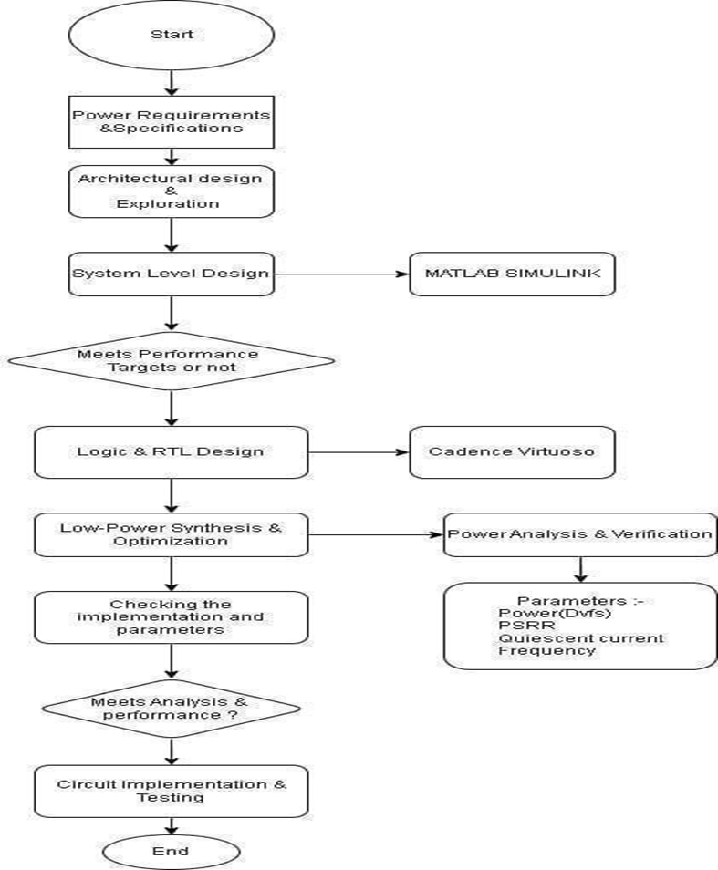
METHODOLOGY
Flowchart of DLDO
8
Dayananda Sagar Academy of Technology & Management

Slide 9
METHODOLOGY
The flowchart shows fig [5.1] the design and verification process of a low-power digital system (for example, a DLDO) from the concept stage to the actual hardware stage.
The very first step to do is defining a device by determining its power requirements and writing specifications such as voltage levels, load, and performance constraints. Voltage reference(vref) =1V, 0.8V, 0.6Va, 0.4V ,0.2V. Voltage Input (vin) =1V, 0.8V, 0.6V, 0.4V, 0.2V. Frequency(f)=10Mhz.and Parameters like Quiescent Current, PSRR, Settling time, Overshoot time.
The immediate next steps after a set of requirements are architectural design and exploration. The goal of this process will be to produce an architectural design that would have an optimum balance of power, performance, and area. Architectural Design consists of Three main blocks Comparator, Shift Register, P-MOS array.
At the system-level design stage, behavior modeling, and simulation of the system with MATLAB Simulink are performed to verify the dynamic performance. The design performance will be sub- targets; hence, the architecture and parameters will be changed accordingly. System Level Modelling consists of Quantizer, Controlled Voltage Source and PID Controller. Voltage reference(vref) = 1,0.8,0.6,0.4,0.2, Resistance (Kohms) = 10,20,30,40,50 and Capacitance(uf) = 10,20,30,40,50.
The next step after obtaining system-level targets is logic and RTL design, local and by circuit-level confirmation with Cadence Virtuoso. Here RTL code id used to create the blocks which were used in architectural design.
Low-power synthesis and optimization techniques are still being employed to keep the design energy- efficient. Techniques were used DVFS (Dynamic Voltage Frequency Scaling) for the Power calculated in circuit design.
Presently, power analysis, and verification are being done alongside the main parameters recording such as power dissipation, PSRR, quiescent current, and operating frequency.
Besides, the implementation and the measured parameters are being very thoroughly checked for their correctness.
In case the design operates as per the analysis and performance requirements, it may be allowed to go to the stage of circuit implementation and testing, thus confirming operation in reality. workflow is complete with the design is successful.
9
Dayananda Sagar Academy of Technology & Management

Slide 10
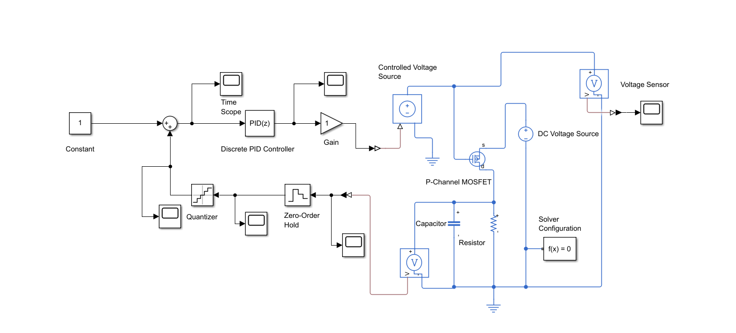
METHODOLOGY
System Level Design of DLDO using SIMULINK
10
Dayananda Sagar Academy of Technology & Management

Slide 11
METHODOLOGY
1. Analysis of output voltage of Simulink (Input Varies)
Input Parameters |  |  | Output Parameters
Input Voltage | Resistance | Capacitance | Output Voltage
1v | 10kohm | 10uf | 11v
2v | 10kohm | 10uf | 22v
3v | 10kohm | 10uf | 33v
4v | 10kohm | 10uf | 44v
5v | 10kohm | 10uf | 55v
11
Dayananda Sagar Academy of Technology & Management

Slide 12
METHODOLOGY
2. Analysis of output voltage of Simulink (Resistance Varies)
Input Parameters |  |  | Output Parameters
Input Voltage | Resistance | Capacitance | Output Voltage
1v | 10kohm | 10uf | 11v
1v | 20kohm | 10uf | 11v
1v | 30kohm | 10uf | 11v
1v | 40kohm | 10uf | 11v
1v | 50kohm | 10uf | 11v
12
Dayananda Sagar Academy of Technology & Management

Slide 13
METHODOLOGY
3. Analysis of output voltage of Simulink (Capacitance Varies)
Input Parameters |  |  | Output Parameters
Input Voltage | Resistance | Capacitance | Output Voltage
1v | 10kohm | 10uf | 11v
1v | 10kohm | 20uf | 11v
1v | 10kohm | 30uf | 11v
1v | 10kohm | 40uf | 11v
1v | 10kohm | 50uf | 11v
13
Dayananda Sagar Academy of Technology & Management

Slide 14
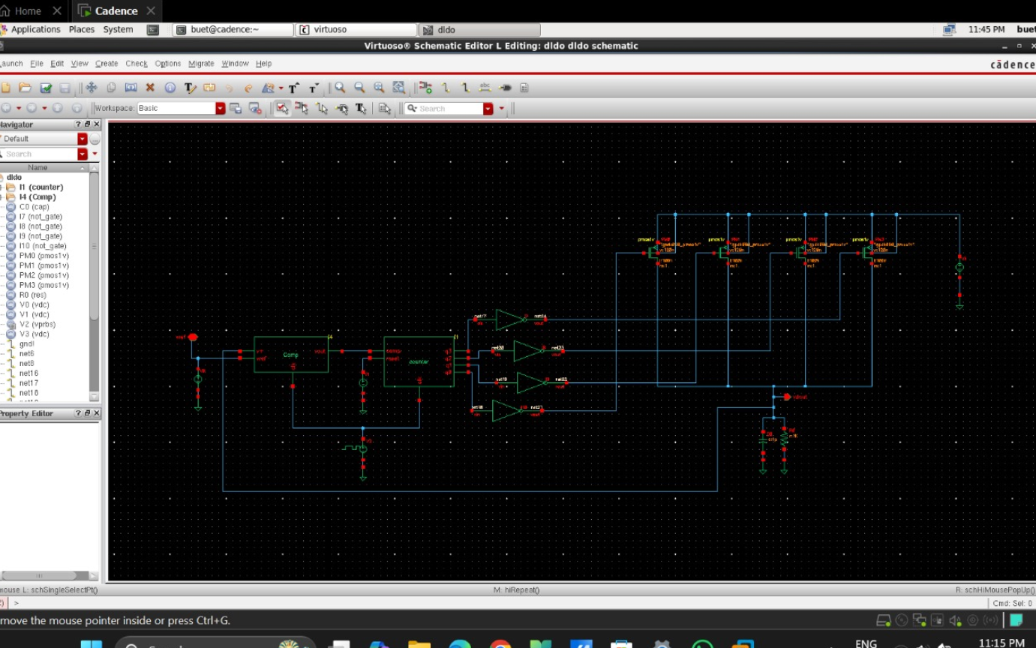
METHODOLOGY
RTL Design of DLDO using Cadence
14
Dayananda Sagar Academy of Technology & Management

Slide 15
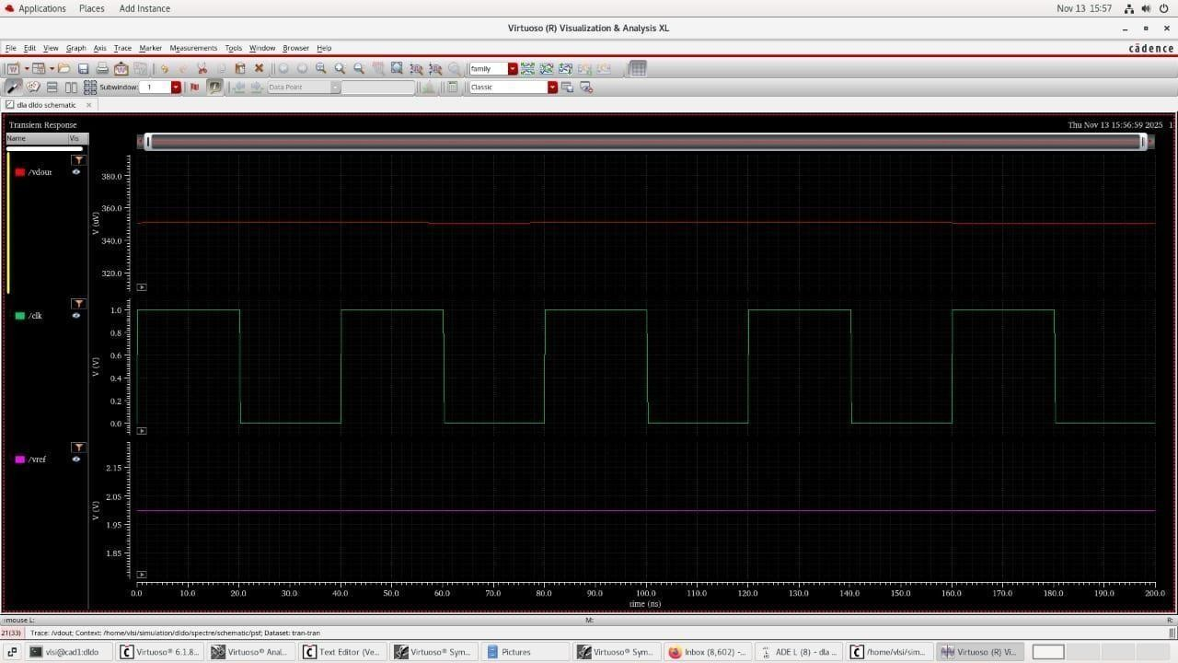
METHODOLOGY
Output of DLDO using Cadence Virtuoso
15
Dayananda Sagar Academy of Technology & Management

Slide 16
CONCLUSION
The objective of designing a low-power Digital Low Dropout Regulator (DLDO) was successfully achieved in this mini-project. The DLDO architecture, implemented using MATLAB for functional modeling and Cadence Virtuoso for transistor-level simulation, demonstrated stable voltage regulation with minimal ripple and efficient power control.
The MATLAB model verified the logical operation of the comparator, digital control logic, and PMOS switching network. The Cadence implementation further confirmed that the regulator maintains a stable output voltage even under clock-driven switching conditions. The transient analysis showed smooth regulation without overshoot, undershoot, or instability, validating the effectiveness of the design.
Overall, the DLDO meets the requirements of low-power operation, reduced heat generation, and improved battery efficiency. This makes it highly suitable for portable electronics, embedded processors, and energy-efficient VLSI systems.
Dayananda Sagar Academy of Technology & Management

Slide 17
REFERENCES
[1]. Yasuyuki Okuma et al., "0.5-V input digital LDO with 98.7% current efficiency and 2.7- µA quiescent current in 65nm CMOS," IEEE Custom Integrated Circuits Conference 2010, San Jose, CA, 2010, pp. 1-4, doi: 10.1109/CICC.2010.5617586.
[2].Design and Verification of Low-Power Integrated Circuits," in IEC 61523-4 Edition 1.0 2015-03 (IEEE Std 1801-2013), vol.,no.,pp.1-351, 24 March 2015, doi:10.1109/IEEESTD.2015.7076554.
[3].Y. -H. Lee et al., "A Low Quiescent Current Asynchronous Digital-LDO With PLL- Modulated Fast-DVS Power Management in 40 nm SoC for MIPS Performance Improvement," in IEEE Journal of Solid-State Circuits, vol. 48, no. 4, pp. 1018-1030, April 2016, doi: 10.1109/JSSC.2013.2237991.
[4]. M. Huang, Y. Lu, S. -W. Sin, S. -P. U, R. P. Martins and W. -H. Ki, "Limit Cycle Oscillation Reduction for Digital Low Dropout Regulators," in IEEE Transactions on Circuits and Systems II: Express Briefs, vol. 63, no. 9, pp. 903-907, Sept. 2016, doi: 10.1109/TCSII.2016.2534778.
[5]. F. Yang and P. K. T. Mok, "A Nanosecond-Transient Fine-Grained Digital LDO With Multi- Step Switching Scheme and Asynchronous Adaptive Pipeline Control," in IEEE Journal of Solid-State Circuits, vol. 52, no. 9, pp. 2463-2474, Sept. 2017, doi: 10.1109/JSSC.2017.2709311.
[6].B. Padmavathi, B. T. Geetha and K. Bhuvaneshwari, "Low power design techniques and implementation strategies adopted in VLSI circuits," 2017 IEEE International Conference on Power, Control, Signals and Instrumentation Engineering (ICPCSI), Chennai, India, 2017, pp. 1764-1767, doi: 10.1109/ICPCSI.2017.8392017.
Dayananda Sagar Academy of Technology & Management

Slide 18
REFERENCES
[7].M. A. Akram, I. -C. Hwang and S. Ha, "Architectural Advancement of Digital Low- Dropout Regulators," in IEEE Access, vol. 8, pp. 137838-137855, 2020, doi: 10.1109/ACCESS.2020.3012467.
[8].W. -B. Yang, C. -H. Sun, D. S. Roy and Y. -M. Chen, "Asynchronous Digital Low- Dropout Regulator With Dual Adjustment Mode in Ultra-Low Voltage Input," in IEEE Access, vol. 9,
pp. 157563-157570, 2021, doi: 10.1109/ACCESS.2021.3128948.
[9]. L. F. Lai et al., "Design Trends and Perspectives of Digital Low Dropout Voltage Regulators for Low Voltage Mobile Applications: A Review," in IEEE Access, vol. 11,pp. 85237-85258, 2023, doi: 10.1109/ACCESS.2023.3303809.
[10]. https://github.com/VaibhavDachewar/Digital-LDO/tree/main
Dayananda Sagar Academy of Technology & Management

Slide 19
THANK YOU
Dayananda Sagar Academy of Technology & Management

